Slide 1
DBMS LAB
EX :1a and 1b

Slide 2
What is SQL?
SQL is a database language designed for the retrieval and management of data in a relational database.
Uses of SQL
It helps users to access data in the RDBMS system.
It helps you to describe the data.
It allows you to define the data in a database and manipulate that specific data.
With the help of SQL commands in DBMS, you can create and drop databases and tables.
SQL offers you to use the function in a database, create a view, and stored procedure.
You can set permissions on tables, procedures, and views.

Slide 3
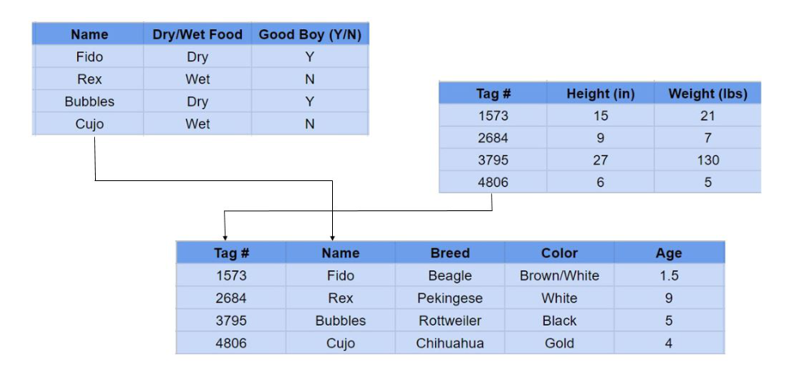
Example of Relational DataBase

Slide 4
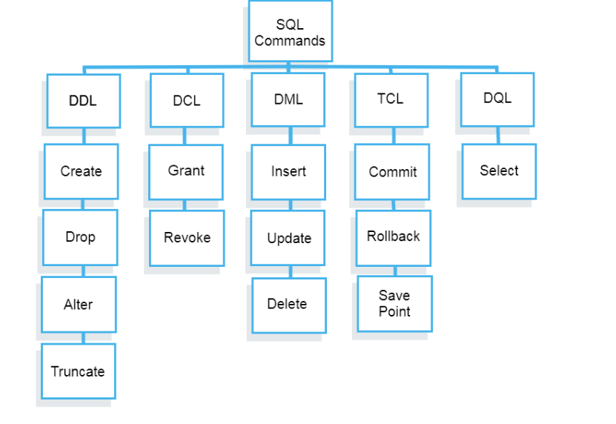
SQL Languages

Slide 5
Data Definition Language(DDL) – Consists of commands which are used to define the database.
Data Manipulation Language(DML) – Consists of commands which are used to manipulate the data present in the database.
Data Control Language(DCL) – Consists of commands which deal with the user permissions and controls of the database system.
Transaction Control Language(TCL) – Consist of commands which deal with the transaction of the database.

Slide 6
What is DDL?
Data Definition Language helps you to define the database structure or schema. Let’s learn about DDL commands with syntax.
List of DDL commands
CREATE: This command is used to create the database or its objects (like table, index, function, views, store procedure, and triggers).
DROP: This command is used to delete objects from the database.
ALTER: This is used to alter the structure of the database.
TRUNCATE: This is used to remove all records from a table, including all spaces allocated for the records are removed.
COMMENT: This is used to add comments to the data dictionary.
RENAME: This is used to rename an object existing in the database.

Slide 7
Data Definition Language (DDL)
List of DDL commands
CREATE: This command is used to create the database or its objects (like table, index, function, views, store procedure, and triggers).
DROP: This command is used to delete objects from the database.
ALTER: This is used to alter the structure of the database.
TRUNCATE: This is used to remove all records from a table, including all spaces allocated for the records are removed.
COMMENT: This is used to add comments to the data dictionary.
RENAME: This is used to rename an object existing in the database.

Slide 8
CREATE command
This statement is used to create a table or a database.
SYNTAX
CREATE TABLE TableName ( Column1 datatype, Column2 datatype, Column3 datatype, .... ColumnN datatype );
Example
CREATE TABLE Employee_Info
(
EmployeeID int,
EmployeeName varchar(255),
Address varchar(255),
City varchar(255),
Country varchar(255)
);

Slide 9
DROP
This statement is used to drop an existing table. When you use this statement, complete information present in the table will be lost.
Syntax
DROP TABLE TableName;
Example
DROP Table Employee_Info;

Slide 10
ALTER
This command is used to delete, modify or add constraints or columns in an existing table.
If you wish to add a column, then you will use the ADD command, and if you wish to delete a column, then you will use the DROP COLUMN command.
Syntax
ALTER TABLE TableName ADD ColumnName Datatype;
ALTER TABLE TableName DROP COLUMN ColumnName;
ADD Column BloodGroup:
ALTER TABLE Employee_Info
ADD BloodGroup varchar(255);
DROP Column BloodGroup:
ALTER TABLE Employee_Info
DROP COLUMN BloodGroup ;

Slide 11
The ‘ALTER TABLE’ Statement with ALTER/MODIFY COLUMN
This statement is used to change the datatype of an existing column in a table.
Syntax
ALTER TABLE TableName ALTER COLUMN ColumnName Datatype;
Example
Add a column DOB and change the data type to Date.
Syntax
ALTER TABLE Employee_Info ADD DOB year;
ALTER TABLE Employee_Info ALTER DOB date;

Slide 12
TRUNCATE:
This command used to delete all the rows from the table and free the space containing the table.
Syntax:
TRUNCATE TABLE table_name;

Slide 13
DML
SELECT: It is used to retrieve data from the database.
INSERT: It is used to insert data into a table.
UPDATE: It is used to update existing data within a table.
DELETE: It is used to delete records from a database table.

Slide 14
Data Manipulation Language (DML)
SELECT: It is used to retrieve data from the database.
Select*from table_name;
INSERT: It is used to insert data into a table.
Syntax
INSERT INTO TableName (Column1, Column2, Column3, ...,ColumnN) VALUES (value1, value2, value3, ...);
If you don't want to mention the column names then use the below syntax
INSERT INTO TableName VALUES (Value1, Value2, Value3, ...);
Example
INSERT INTO Employee_Info(EmployeeID, EmployeeName, Emergency ContactName, PhoneNumber, Address, City, Country) VALUES ('06', 'Sanjana','Jagannath', '9921321141', 'Camel Street House No 12', 'Chennai', 'India');
INSERT INTO Employee_Info VALUES ('07', 'Sayantini','Praveen', '9934567654', 'Nice Road 21', 'Pune', 'India');

Slide 15
UPDATE:
It is used to update existing data within a table.
This statement is used to modify the records already present in the table.
Syntax
UPDATE TableName SET Column1 = Value1, Column2 = Value2, ... WHERE Condition;
Example
UPDATE Employee_Info SET EmployeeName = 'Aahana', City= 'Ahmedabad'
WHERE EmployeeID = 1;
DELETE: It is used to delete records from a database table.
This statement is used to delete the existing records in a table.
Syntax
DELETE FROM TableName WHERE Condition;
Example
DELETE FROM Employee_Info WHERE EmployeeName='Preeti';

Slide 16
ALTER
Alters command allows you to alter the structure of the database.
Syntax:
To add a new column in the table
ALTER TABLE table_name ADD column_name COLUMN-definition;
To modify an existing column in the table:
Syntax:
ALTER TABLE MODIFY(COLUMN DEFINITION....);

Slide 17
SQL CONSTRAINTS
SQL constraints are used to specify rules for data in a table.
Constraints are used to limit the type of data that can go into a table.
This ensures the accuracy and reliability of the data in the table.
Constraints can be column level or table level.
Column level constraints apply to a column, and table level constraints apply to the whole table.

Slide 18
TYPES OF CONSTRAINTS
NOT NULL - Ensures that a column cannot have a NULL value
UNIQUE - Ensures that all values in a column are different
PRIMARY KEY - A combination of a NOT NULL and UNIQUE. Uniquely identifies each row in a table
FOREIGN KEY - Prevents actions that would destroy links between tables
CHECK - Ensures that the values in a column satisfies a specific condition
DEFAULT - Sets a default value for a column if no value is specified
CREATE INDEX - Used to create and retrieve data from the database very quickly

Slide 19
SQL Create Constraints
Constraints can be specified when the table is created with the CREATE TABLE statement, or after the table is created with the ALTER TABLE statement.
Syntax:
CREATE TABLE table_name (
column1 datatype constraint,
column2 datatype constraint,
column3 datatype constraint,
....
);
SQL constraints are used to specify rules for the data in a table.
Constraints can be column level or table level. Column level constraints apply to a column, and table level constraints apply to the whole table.
Constraints are used to limit the type of data that can go into a table.

Slide 20
SQL NOT NULL Constraint
By default, a column can hold NULL values.
The NOT NULL constraint enforces a column to NOT accept NULL values.
CREATE TABLE Persons (
ID int NOT NULL,
LastName varchar(255) NOT NULL,
FirstName varchar(255) NOT NULL,
Age int
);

Slide 21
SQL UNIQUE Constraint
The UNIQUE constraint ensures that all values in a column are different.
Both the UNIQUE and PRIMARY KEY constraints provide a guarantee for uniqueness for a column or set of columns.
CREATE TABLE Persons (
ID int NOT NULL UNIQUE,
LastName varchar(255) NOT NULL,
FirstName varchar(255),
Age int
);

Slide 22
SQL PRIMARY KEY Constraint
The PRIMARY KEY constraint uniquely identifies each record in a table.
Primary keys must contain UNIQUE values, and cannot contain NULL values.
A table can have only ONE primary key; and in the table, this primary
key can consist of single or multiple columns (fields).
CREATE TABLE Persons (
ID int NOT NULL PRIMARY KEY,
LastName varchar(255) NOT NULL,
FirstName varchar(255),
Age int
);

Slide 23
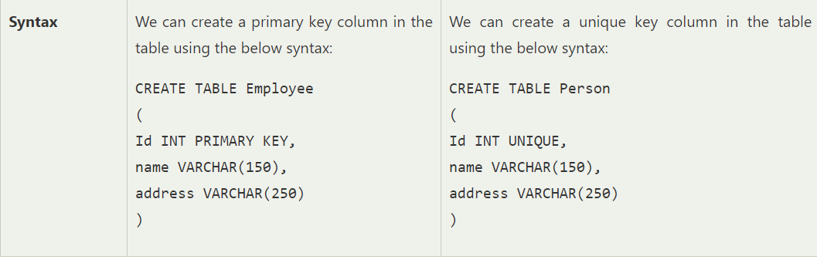
Difference between Primary and Unique Key

Slide 24
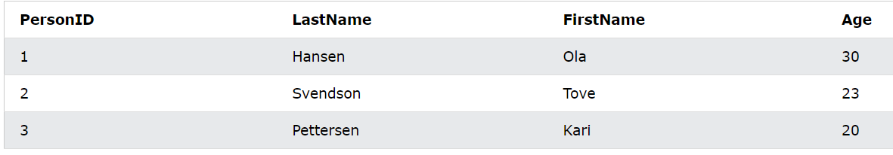
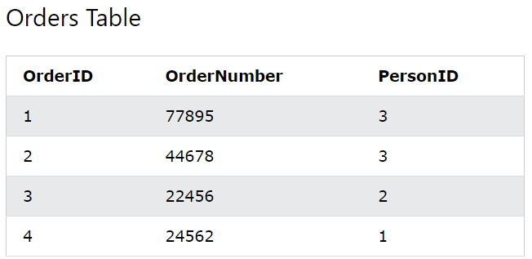
Persons table
FOREIGN KEY CONSTRAINTS
A FOREIGN KEY is a field (or collection of fields) in one table, that refers to the PRIMARY KEY in another table.
→The table with the foreign key is called the child table, and the table with the primary key is called the referenced or parent table.
Syntax
CREATE TABLE Orders (
OrderID number NOT NULL PRIMARY KEY,
OrderNumber number NOT NULL,
PersonI Dnumber FOREIGN KEY REFERENCES Persons(PersonID));

Slide 25
CHECK CONSTRAINTS
The CHECK constraint is used to limit the value range that can be placed in a column.
If you define a CHECK constraint on a column it will allow only certain values for this column.
If you define a CHECK constraint on a table it can limit the values in certain columns based on values in other columns in the row.
CREATE TABLE Persons (
ID int NOT NULL,
LastName varchar(255) NOT NULL,
FirstName varchar(255),
Age int CHECK (Age>=18)
);

Slide 26
PRIMARY KEY CONSTRAINT
CREATE TABLE Persons (
ID int NOT NULL,
LastName varchar(255) NOT NULL,
FirstName varchar(255),
Age int,
CONSTRAINT PK_Person PRIMARY KEY (ID,LastName)
);

Slide 27
PRIMARY KEY CONSTRAINT
ALTER TABLE Persons
ADD CONSTRAINT PK_Person PRIMARY KEY (ID,LastName);

Slide 28
FOREIGN KEY CONSTRAINT
CREATE TABLE Orders (
OrderID int NOT NULL,
OrderNumber int NOT NULL,
PersonID int,
PRIMARY KEY (OrderID),
CONSTRAINT FK_PersonOrder FOREIGN KEY (PersonID)
REFERENCES Persons(PersonID)
);

